Slide 1
Boxify Churn Analysis
Prepared By : Rishab Bansal
Data Analyst | Business Analyst

Slide 2
BUSINESS PROBLEM & OBJECTIVES
About Boxify
Boxify, an online subscription box service delivering monthly lifestyle products. Over the past year, the company has observed a rise in customer churn subscribers cancelling before completing 6 months. Management wants to understand why customers leave and take action to improve retention.
Key Assumptions
The data available is for the last 3 years.
Assume monthly subscription renewals.
Churn can only be measured at the end of a subscription cycle.

Slide 3
Strategic Objectives
Reduce churn rate by 5–10% over the next 6 months.
Identify high-risk customer segments.
Recommend strategies to retain subscribers and increase loyalty.

Slide 4
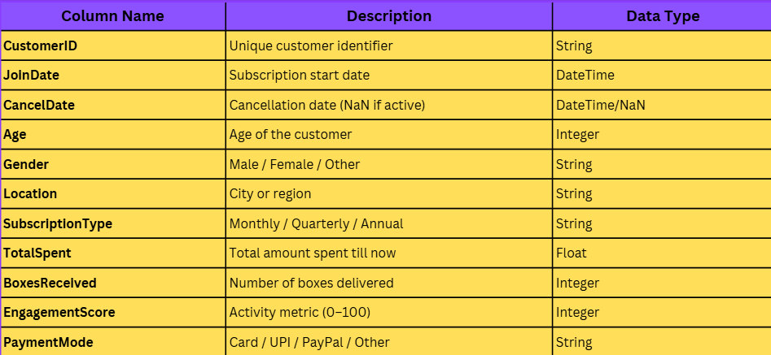
Dataset Given
DATASET OVERVIEW

Slide 5
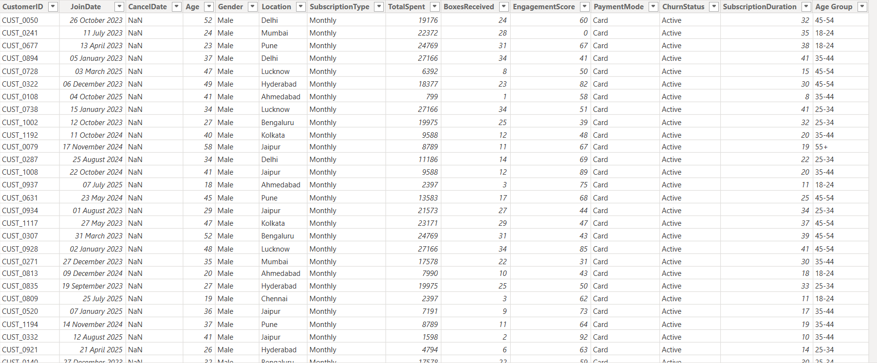
DATASET AFTER CALCULATED COLUMNS

Slide 6
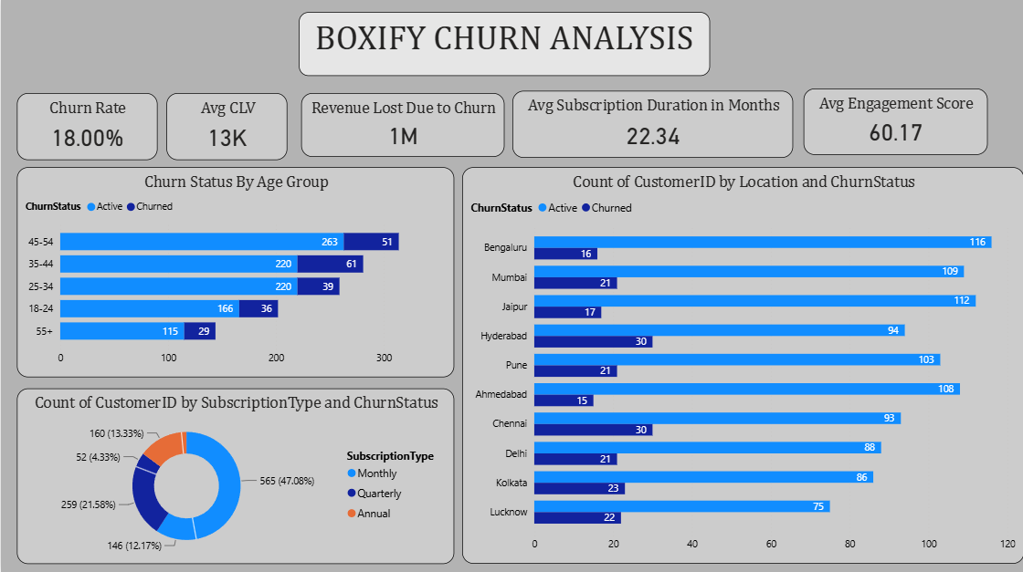
KPI OVERVIEW

Slide 7
WHICH SEGMENTS CHURN THE MOST
Key Insight: Age 35–44 has the highest churn count (61). Monthly subscribers are 2.2× more likely to churn than annual subscribers. Immediate focus should be on converting monthly to longer-term plans.

Slide 8
CHURN BY LOCATION – GEOGRAPHIC HOTSPOTS
Churn is highest in Chennai (24.4%), Hyderabad (24.2%), and Lucknow (22.7%), indicating these cities are the most critical churn hotspots and require immediate retention efforts.
Recommendation: Launch targeted retention campaigns in these cities, such as personalized offers, loyalty rewards, proactive customer support, and feedback surveys to address local customer pain points and reduce churn.

Slide 9
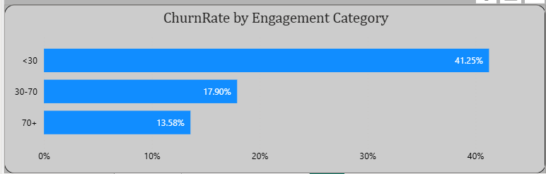
ENGAGEMENT LEVEL vs CHURN CORRELATION
Customers with low engagement (<30) have a significantly higher churn rate (41.25%), compared to medium (17.90%) and highly engaged customers (13.58%). This indicates a strong negative relationship between engagement and churn. Recommendation: Implement engagement-boosting initiatives such as personalized content, loyalty programs, onboarding campaigns, and regular communication to increase customer activity and reduce churn risk.

Slide 10
PREDICTING POTENTIAL CHURNERS
Low Engagement Score
Subscription Type
Monthly Box Volume
Early Warning Signal: Any customer with Engagement < 40 + Monthly plan → High churn probability

Slide 11
KEY INSIGHTS & HIDDEN TRENDS
Age 35–44 shows highest churn (61 churned), while 55+ has the lowest churn risk
Monthly subscribers (47%) churn far more than Quarterly or Annual plans
Bengaluru leads churn with 16 churned customers; Hyderabad has the highest rate (30 churned)
Low engagement score strongly correlates with elevated churn — targeting score <30 is critical

Slide 12
RECOMMENDATIONS
Plan Upgrade Incentives - Offer 15–20% discount on Annual plans to Monthly subscribers at risk.
Re-Engagement Email Campaigns - Automated 3-email drip for users with engagement score 30–50. Include curated box previews and 'We miss you' offers.
In-App Loyalty Program - Points-based rewards for unboxing reviews, referrals, and consecutive months. Gamification lifts engagement scores.
Proactive Customer Success – Assign CS reps to monitor accounts crossing 60% churn probability. One personal check-in call or offer mail can reduces churn.
City-specific campaigns - Focus city-specific campaigns on Hyderabad, Chennai & Lucknow (highest churn rates)

Slide 13
Projected Impacts
Reduce churn to <12%
Recover ₹5L+ revenue
Improve avg engagement to 70+
Increase annual plan adoption by 15%

Slide 14
Thank You

